Slide 1
Lesson 8 Hands-On
By Alexander Olvera

Slide 2
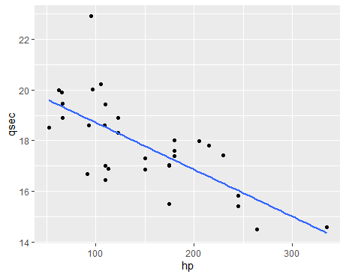
Create a scatter plot with a trend line where the horizontal axis is engine horsepower and the vertical axis is quarter mile time. What is the relationship between time and engine horsepower: positively correlated, negatively correlated, or uncorrelated?
The relationship between time and engine horsepower is negatively correlated.

Slide 3
Compute the linear regression for time and engine horsepower. What is the equation of the line? What is the R-squared value? Is this what you would expect?
Residual standard error: 1.282 on 30 degrees of freedom
Multiple R-squared: 0.5016, Adjusted R-squared: 0.485
F-statistic: 30.19 on 1 and 30 DF, p-value: 5.766e-06
Equation for the line: (y = -0.02x + 20.56)
I would expect that the more horsepower the vehicle has, the quicker it can go. However, there are vehicles that are inherently more efficient and aerodynamic, thus being an important factor when calculating the quarter mile times.

Slide 4
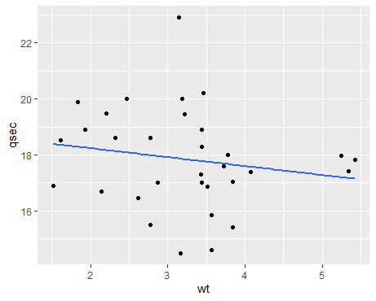
Create a scatter plot with a trend line where the horizontal axis is vehicle weight and the vertical axis is quarter mile time. What is this relationship: positively correlated, negatively correlated, or uncorrelated?
The relationship between weight and time is uncorrelated.

Slide 5
Compute the linear regression for these two variables. What is the equation of the line? What is the R-squared value? Is this what you would expect?
Residual standard error: 1.789 on 30 degrees of freedom
Multiple R-squared: 0.03053, Adjusted R-squared: -0.00179
F-statistic: 0.9446 on 1 and 30 DF, p-value: 0.3389
Equation for the line: (y = -.32x + 18.88)
I would generally have expected that the more a car weighs, the slower it would be. But this is assuming each car measured carries the same overall build and components. Different vehicles have different engines, body kits, tires, etc.

Slide 6
Code used
data(mtcars)
View(mtcars)
library("ggplot2")
ggplot(data=mtcars, aes(x = hp, y = qsec)) + geom_point() + geom_smooth(method='lm', se = FALSE)
Regression1 <- lm(qsec~hp, mtcars)
summary(Regression1)
ggplot(data=mtcars, aes(x = wt, y = qsec)) + geom_point() + geom_smooth(method='lm', se = FALSE)
regression2 <- lm(qsec~wt, mtcars)
summary(regression2)

